Slide 1
Analyzing meta-genomes and meta-transcriptomes using compositional data methods
🐯
🐞
👽
Greg Gloor
Department of Biochemistry
University of Western Ontario

Slide 2
Outline
🐯
🐞
👽
Demonstration of the problem
Problem applies, without restriction, to meta-genomics, meta-transcriptomics, transcriptomics, etc.
Tools in common use sensitive to abundance, not variance
Probabilities and compositions
Sequencing is not counting
Sequencing is a fixed-sum random sampling process
Meta-transcriptome analysis
Waste-water treatment plant
Bacterial vaginosis

Slide 3
The sequencing meat grinder
🐯
🐞
👽

Slide 4
Data as counts
🐯
🐞
👽
Counts in the environment
Vast majority of molecules maintain same absolute abundance
~75 increase in abundance
‘Counts’ after sequencing
Vast majority appear to have decreased
Small number increased

Slide 5
Data as log-ratio probabilities
🐯
🐞
👽
‘Counts’
Log-ratio of probabilities

Slide 6
Multivariate and univariate methods often disagree
🐯
🐞
👽
Multivariate group differences driven by the most abundant features in the groups
Distance/dissimilarity metrics sensitive to abundance, read depth, subsetting, other confounders (Lozupone AEM 2005, Gorvitovskaia Microbiome 2016, Wong PLoS ONE 2016)
Between group univariate differences are usually the rarest
FP rates driven by sparsity (Thorsen Microbiome 2016)
FP rates not grounded in reality (Hawindel Brief Bioinfo 2017)

Slide 7

🐯
🐞
👽
Sequencing data are high-dimensional
Therefore statistical analyses can be wildly optimistic
(Thorsen MB 2016, Hawindel BB 2017)
Sequencing data are sparse
Therefore we need to estimate many of our values
(Tsilimigras MB 2016, White PLoS CB 2009)
Sequencing data are probabilities/compositions
Applies to any ?-Seq experiment
(Friedman PLoS CB 2011, Lovell PLoS CB 2015, Gloor AE 2016)
Most of us are unaware of the problems

Slide 8

‘Donalds’ give the best quotes
🐯
🐞
👽
There are known knowns. These are things we know that we know.
There are known unknowns. That is to say, there are things that we know we don't know.
But there are also unknown unknowns. There are things we don't know we don't know.
There are unknown knowns. These are things we think we know that we actually don’t know.

Slide 9
🐯
🐞
👽
Sequencing data are high-dimensional
Therefore statistical analyses can be wildly optimistic (Thorsen MB 2016, Hawindel BB 2017)
Sequencing data are sparse
Therefore we need to estimate many of our values (Tsilimigras MB 2016, White PLoS CB 2009)
Sequencing data are probabilities/compositions
Applies to any ?-Seq experiment (Friedman, Lovell PLoS CB 2011, 2015, Gloor AE 2016)
Most of us are unaware of the implications

Slide 10
We imagine
🐯
🐞
👽
👽
👽
👽
👽
Notes:
Starting with a of molecules composed of Tigers and Ladybugs
We take a random sample, how many Tigers and how many Ladybugs
If we count a given random area we can infer how many off each there are in entire set

Slide 11
Counting our things
🐯
🐞
👽
Example 100 random sample sets
range=1800-2200
range= 8000-12000
range=450-550
🐯
🐞
👽

Slide 12
HTS is not counting
🐯
🐞
👽
Sequencing machines randomly sample the environment with a fixed capacity
Cannot just ‘add one more read’ forever
They do not deliver counts
Values are probabilities scaled by the total number of reads
Any total is equivalent to any other
Friedman 2012 PLoS Comp Bio
Gloor, et al. 2016. Ann Epidemiology
Gloor, et al. 2016. Can J. Micro

Slide 13
Proportions have strange properties
🐯
🐞
👽
Constant sum of 1000
Constant sum operations:
Count normalization
Rarefaction
Proportion
percentage, relative abundance
RNA-seq, metagenomics, tag-sequencing
Gloor, et al. 2016. Ann Epidemiology
Gloor, et al. 2016. Can J. Micro

Slide 14
But my data are not affected …
🐯
🐞
👽
Transcriptome
Remove rRNA, tRNA, snRNA, etc.
Or only mRNA, snRNA, tRNA, etc.
Different amounts of RNA in the system
Marker gene sequencing
Primer bias
Remove low-counts, singletons, sparsity, chimeras, etc.
Total bacterial load varies
Asymmetry of occurrence
Metagenome
Total bacterial load varies
DNA isolation bias
Asymmetry of occurrence

Slide 15
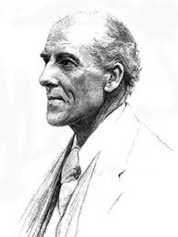
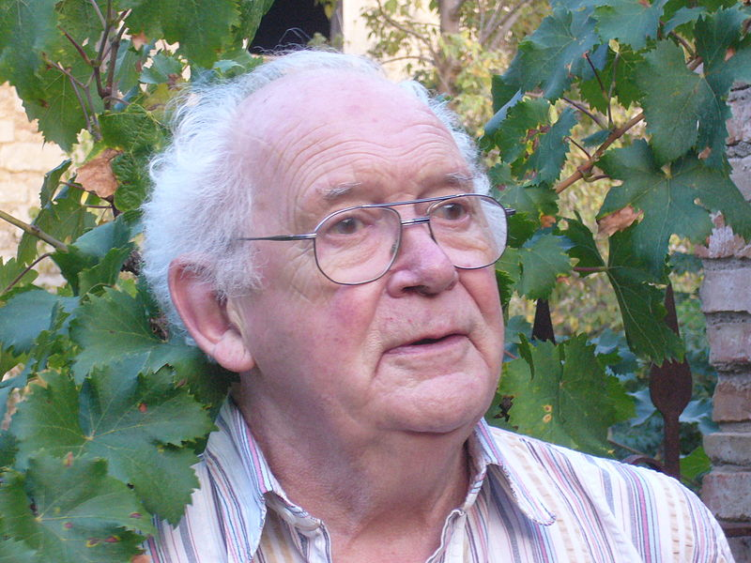
CoDa
🐯
🐞
👽
Compositional data are logically inconsistent with most tools in common use (Pearson 1897)
correlation, PCA etc.
negative binomial, rarefaction, ZIG
The solution is to work in ratios
Aitchison and others
Conceptually similar to qPCR

Slide 16
CoDa properties and the *lr
Count
Sequencing
Simplex
🐯
🐞
👽
27
853
66
740
112
216
Simplex: one fewer dimensions than variables
Problems remain regardless of dimension
X = [ x₁, x₂, … x_{D} ], g_{X} = geometric mean of X (or subset)
*lr(x) = [ log(x₁/g_{X}), log(x₂/g_{X}), … log(x_{D}/g_{X}) ]
*lr transformed data are scale invariant
Formally, all pairs of ratios measured
Ratios are linearly related
Aitchison 1986. Stat. Anal. Comp Data
Pawlowsky-Glahn, 2015. Mod. Anal. CoDa
Notes:
Scale dependence - hence ‘normalization’
Correlation and covariation are unreliable
Addition and subtraction are not useful operations
Subsetting and aggregating are problematic
Sparse data is an issue

Slide 17
Correlation in CoDa
🐯
🐞
👽
spurious correlation
Correlation observed is not the same for the numerical and proportional data
or for a subset of that data
Whenever any two variables that share a common denominator (or a constant sum).
Correlation in these data must maintain a constant ratio
Pearson correlation with an intercept of 0 (proportion), or linear line with a slope of 1 (log-ratio)

Slide 18
The 0 in the room
0 count can be real – or a non-detect
Sequencing instruments deliver scaled probabilities
X=[x₁,x₂,x_{i} … x_{D}] = [p₁,p₂,p_{i} … p_{D}]α ; α=ΣX; ΣP=1
x_{i} = ( P_{i} | 𝑓_{i} )α
Our approach (ALDEx2)
p_{i} = 0 is very strong assumption; [P_{i} > 0, P_{i} →0]
Generate a Bayesian posterior distribution of probabilities for each count in each sample; clr transform the distribution; perform analyses on each element in the distribution; report expected values
Dramatically reduces false positives with little or no loss of sensitivity for essentially any seq’omics dataset
🐯
🐞
👽
Fernandes, PLoS ONE 2013
Gloor, Aus J. Stat. 2016
Thorsen, Microbiome 2016

Slide 19
Examine variance of the ratios between featues
🐯
🐞
👽
Examine variance not abundance
Easily interpret relationships between samples and features
Robust to perturbations
Exploratory data analysis
Differential abundance
Compositional association
Notes:
Compositional data is analyzed based on the variance of the ratios between parts. Regardless of the approach the first step is to replace 0 values prior to clr transformation. This is an open problem, but the best current approaches incorporate Bayesian estimation. I am developing CoDaSeq, an integrated toolkit that adapts the tools used for compositional data analysis in other domains to the analysis if HTS. With these tools we can find outliers, perform exploratory data analysis, examine differential abundance and find associated variables. The toolkit is applicable to many different HTS designs including transcriptome, metagenome and 16S rRNA gene sequencing. The latter will be used as an esample, since these data are the least tractable to the CoDa approach

Slide 20
Available tools
🐯
🐞
👽
Outliers & filters
CoDaSeq (github.com/ggloor)
Exploratory data analysis
Compositional biplots (compostions - CRAN)
omicplotR (Dan Giguere: github.com/dgiguer/omicplotR/wiki)
philr (Bioconductor)
Differential abundance
ALDEx2 (Bioconductor)
ANCOM (QIIME)
Compositional association
propr (CRAN)

Slide 21
Meta-transcriptomics of ecosystem
🐯
🐞
👽
Information about what is being made ‘at that moment’
Often unbalanced
Both absolute and relative abundance of the taxa and their transcripts can change
Different conditions can have different taxonomic compositions
Relative abundance not necessarily reflective of 16S rRNA gene sequencing or metagenomic sequencing

Slide 22
Meta-transcriptome of samples from refinery wastewater treatment plant
🐯
🐞
👽
grown in two carbon sources
Each point is a gene (>250k)
Y-axis is E(difference) between groups
X-axis is E(dispersion) within group
Alkanes in Medium B, benzoate in both media

Slide 23
What uses media differently?
🐯
🐞
👽
Meta-transcriptome of samples from refinery wastewater treatment plant grown in two carbon sources
Each point is a gene (>250k)
Y-axis is E(difference) between groups
X-axis is E(dispersion) within group
Alkanes in Medium B, benzoate in both media
Lysinbacillus prefers alkanes

Slide 24
Meta-transcriptome of H vs. BV
🐯
🐞
👽
Macklain, McMillan- PC
McMillan, Sci. Rep, 2015

Slide 25
Gene vs. function level analysis
🐯
🐞
👽
Gene level shows species or strain level contribution
Function level is redundant - e.g. housekeeping functions collapse
Notes:
I mentioned before that we also grouped refseq clusters into functional groups by comparison to the SEED subsystem database
On the left is the biplot I just showed you at the refseq, or taxonomic level, and on the right is plotting the same data that has now been binned into subsystem4 groups
The samples fall into the same four inferred subgroups that were shown by hierarchical clustering on the previous plot, and these, again, correspond to different subtypes of the disease condition
The major split on component one is still between the healthy and dysbiotic BV state, but in this case there is better separation - larger PC1 (41% vs 52%)
This suggests two key conclusions
1. That there is a redundancy in functions despite differences in taxonomic composition. In other words, different species can contribute to the same functions
2. That these conserved biochemical functions are the major unit of interest contributing to the condition (rather than individual genes)
This is starting to think of the system as a meta-organism instead of individuals in a community

Slide 26
What separates BV subgroups?
ALDEx2 Effect size:
E(difference)
E(dispersion)
🐯
🐞
👽
Notes:
One outstanding question I had was once we’d identified two BV subgroups, was to find out which specific functions were different between them
For this I used ALDEx which uses principles of Compositional Data Analysis and effect sizes to infer differences between groups
The effect size is a a ratio of the between-condition difference over the within condition variance
Each dot is an individual function plotted by a higher level group. On the x-axis is the Effect size as a way to visualize the magnitude of the change
Colored dots (red or blue for each condition) are significantly different
Some differences are metabolic (which we expectedly see in the metabolome) and some are structural (which we would not see in the metabolize analysis)

Slide 27
Summary
🐯
🐞
👽
Analysis | Standard (count) | CoDa/probability
Beta Diversity | Driven by most abundant taxon or gene | Variance of ratios between taxa or genes
Clustering | Driven by most abundant taxon or gene | Variance of ratios between taxa or genes
Differential abundance | Usually rarest taxon or gene – most variable within and between groups | Variance of ratios between taxa or genes –most variable between groups
Correlation | Just wrong – many false positives | Pairs of taxa or genes that have common variance
Interpretation | Seems simple but is not | Seems hard but is not

Slide 28
Conclusions
🐯
🐞
👽
We only have relative information
Need to recast our questions. How are things changing relative to each other?
It takes a shift in thinking to interpret the data correctly
Variances of the ratios is informative
Same features are identified through multivariate ordination, univariate differential abundance, compositional association
0 replacement is a theoretical, but not a practical impediment
Gloor 2016, Aus. J. Stat

Slide 29

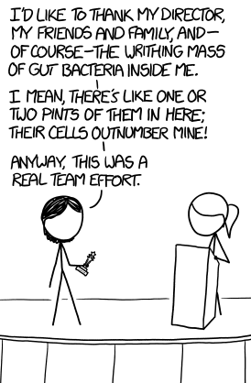






Acknowledgments
🐯
🐞
👽
Andrew
Fernandes
Jean
Macklaim
Vera Pawlowsky-Glahn
Juan Jose Egozcue
Justin Silverman
philr (Bctor)
Tom Quinn
propr (CRAN)
🐯
🐞
👽
Gregor Reid
Jeremy Burton
Amy McMillan
Daniel Giguere
Jia Rong Wu
Notes:
Many more fragments than we can count

Slide 30
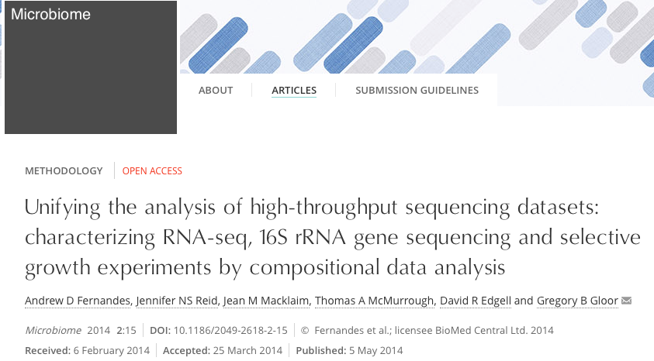

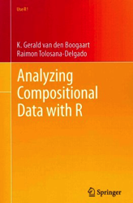
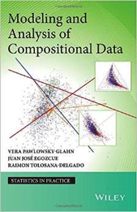
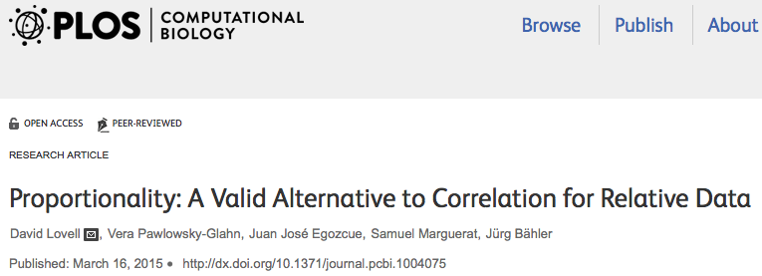
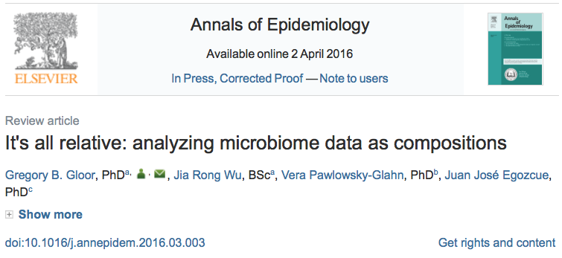

Reading & Sources
🐯
🐞
👽

Slide 31
Fake Correlations!!!
🐯
🐞
👽
In addition to spurious correlation
False positive –ve correlations because …
what is the correlation between heads and tails?
False positive +ve correlations because associations must maintain a constant ratio …

Slide 32
The Ø metric propr, CoDaSeq
🐯
🐞
👽
Ø = 1 + ß² -2ß|r|
r=1 when two vectors in same direction
ß=1 when the two vectors have the same variance
So Ø = 0 iff r=2 & ß=1
Collapsing two measures into one number
Lovell, PLoS Comp. Bio. 2015
Erb, Theor. Biosci. 2016

Slide 33
Where is the noise?
Variance vs. mean for data on the simplex
Transcriptome datset
Top shows absolute data, with near linear dependence
Modeled by negative binomial
Lowest and highest counts have least variance
0 is 0!
Inflates statistical significance at low count margin
Bottom shows relative data, non-linear dependence on ratios
Follows approximate Dirichlet
Lowest and highest counts have least variance, but 0 is 0!
Inflates statistical significance at low count margin
🐯
🐞
👽
Fernandes, et al. 2013. PLoS ONE
Gloor et al. 2016. Aus. J. Statistics

Slide 34
Bayesian estimate
🐯
🐞
👽
Variance vs. mean for data on the simplex
Top shows point estimate
Follows approximate Dirichlet
Lowest and highest counts have least variance, but 0 is 0!
Inflates statistical significance at low count margin
Bottom shows Bayesian estimate
Probabilities not counts
Drawn from Dirichlet
Values replaced by estimated probability of observing variable given total
Highest counts have least variance
Low counts must be very different to be significant at low count margin

Slide 35
Modeling technical variation
🐯
🐞
👽
Distribution of values in replicate B for replicate A values
Transcriptome dataset
True technical variation in black
Inferred technical variation in red
Gloor et al. 2016. Aus. J. Statistics

Slide 36
Find test values not affected by random sampling
🐯
🐞
👽
Group 1 Group 2
ALDEx2
Generate posterior estimates of the data consistent with the observed data and the chosen prior(s)
Dirichlet instances
clr transform instances
Calculate univariate test values on each instance
Correct for FDR
Report the expected value of each test across instances
Fernandes, et al. 2013. PLoS ONE
Fernandes, et al. 2014. Microbiome
Notes:
Many more fragments than we can count

Slide 37
Effect-sizes
🐯
🐞
👽
E=Difference/Dispersion
SELEX dataset
Convenient way to summarize univariate differences in multivariate data
X axis - maximum variation within either group for each feature
Y axis – Difference between groups for each feature
Lines indicate effect size boundaries
D=1, V=2 E=0.5
D=1 V=0.5 E=2
D=2 V=2 E=1
Read the plot in sectors
Most 16S rRNA sequencing experiments have E < 1
Transcriptome experiments E > 2
Gloor et al. 2016. J. Comp. Graph. Stat.
Notes:
Many more fragments than we can count

Slide 38
P-values are not reliable
🐯
🐞
👽
Yeast transcriptome dataset
48 replicates, 2 conditions
Randomly choose n replicates
Calculate P and corrected P (q)
‘Truth’ is q < 0.05 of 48 replicates
Halsey, Nature Meth. 2015

Slide 39
Effect sizes are stable estimates
🐯
🐞
👽
E >= 1
E >= 2
Halsey, Nature Meth. 2015

Slide 40
The Ø metric
🐯
🐞
👽
Ø = 1 + ß2 -2ßr
x_{i} = clr(x_{i}), x_{j} = clr(_{xj})
Ø_{ij} = ( var(x_{i}) – var(x_{j}) ) / (var(x_{i}) + var(x_{j}))
Lovell, PLoS Comp. Bio. 2015

